Slide 1
AWS Networking 101
Fundamentals
Notes:
How many here are already familiar with AWS Networking 101?

Slide 2
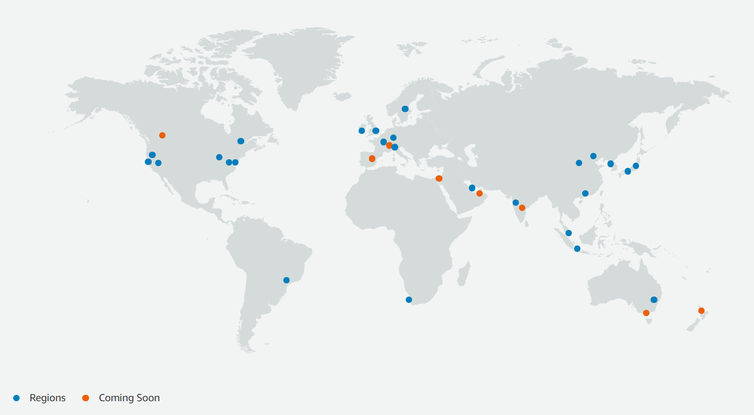

AWS Region
AWS account
Notes:
So, let’s start talking about what the Aws region is. Aws has regions all over the world, the region is a presence where you can run services in a specific geoghrapic location. Usually you chose the region that is close to where your company resides. You need to pick the region before spinning up your instances.
But what is really a region?

Slide 3

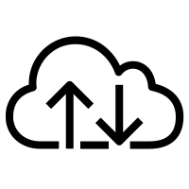

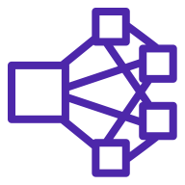

AWS Region
AWS Region
AWS account
Availability Zone
Data center
Data center
Internet
Availability Zone
Data center
Data center
AWS Global Backbone
Data center
Notes:
Let’s go ahead and kind zoom in a region, we are gonna pick a specific region and we are gonna see what is inside a region. What does it look like?
An AWS region is a large geographic area and it comprises multipe AWS DCs and those DCs are combined in what they call AVAILABILITY ZONES.
An availability zone can include one or more DCs, and they are all in the same local area, maybe crossing the street from each other, and the connection between them is the typical high speed low latency connection.
The availability zone looks like a failure zone, this means that if a power outage occurs, only one availability zone will be affected, or let me rephrase the likelihood that all the availability zones in that region would be affected is very low. Each availability zone is distant from the others in a way that they do not share the same power grid; they should be miles away from each other.
When we have at least two AZs, we can call it an aws region. There will never be a Region with only one Availability zone.
Each AZ is connected to Internet, likewise with the aws global backbone network. So this is essentialy a snapshot of what an aws region looks like.

Slide 4
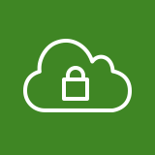
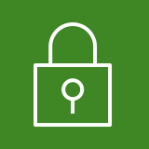



Amazon Virtual Private Cloud (VPC)
AWS account
The VPC only exists within:
One AWS Account
One AWS Region
AWS Region
Availability Zone 1
Availability Zone 2
VPC
& IPv6 optional
10.1.0.0/16
VPC
The VPC spans multiple availability zones in a region
Public subnet
Public subnet
VPC Subnet is confined to a single availability zone
EC2 Instance
EC2 Instance
10.1.3.0/24
10.1.4.0/24
Flow logs
You can have many VPCs in each account and region
Private subnet
Private subnet
EC2 Instance
EC2 Instance
10.1.1.0/24
10.1.2.0/24
Can enable VPC Flow logs for traffic flow data
Notes:
Now let’s move to the VPC, the Virtual Private Cloud.
Of course, I have created my AWS account, and then I have chosen the concerned region.
I have picked my region and there, I have multiple AZs and now I can create what is called VPC.
This is a private network that you are creating inside the AWS infrastructure, you can define the cidr block from whom you can generate subnets.
In this example, we are using the cidr range 10.1.0.0/16 and you are also allowed to activate IPv6 if you desire it.
You can break down the cidr and create multiple subnets. The VPC as you can see, can span two or more availability zones in the region where it has been created, whereas a subnet is confined within an Availability zone. The VPC can only exist in a single region, It can’t span multiple regions, you can’t stratch it across multiple regions.
In the picture it is mentioned that some subnets are identified as public subnets and other subnets are identified as private ones, and I will explain this later down the line.
Then you can launch ec2 instances in the subnets.
(click)Of course, you can create multiple VPCs in each region.
In each region you can enable the VPC Flow Logs, this is just a way to fetch information about the traffic that is going in and out the vpc. Flow logs provides just a text file, therefore just imagine that if you activate it on all the vpcs per each account, you will get several text files and if you want to cross check these files, you need to aggregate these data, and once I have them aggregated I will be able to visualize them and to query them.f If you want to aggregate these data you need to use other services such as amazon cloudwatch, amazon athena, amazon quicksight. You need to architect a solution and manage it just for visualizing the outcomes of your data.
On our solution you don’t need to build any architecture involving the activation of multiple services. The Copilot provides out-of-the-box a simplified and rich single pane of glass.

Slide 5


Elastic Network Interface (ENI)
VPC
Availability Zone 1
10.1.0.0/16
Availability Zone 2
Private subnet
10.1.5.33
Public subnet
EC2 Instance
Elastic IP Address (EIP)
10.1.5.73
32.14.196.7
10.1.4.36
10.1.5.0/24
EC2 Instance
Can have multiple ENIs per EC2 instance
10.1.4.0/24
Private subnet
10.1.1.12
Private subnet
Elastic network interface
EC2 Instance
ENI and EC2 instance must be in the same availability zone
10.1.1.0/24
10.1.2.0/24
Notes:
Now let’s talk about the eni, the “elastic network interface”.
When you launch an ec2 instance, you need to pick a subnet and the ec2 instance will be instantiated within that subnet, and an interface will be assigned to it.
That interface will receive an IP address from the subnet pool, automatically, or you can also assign it for yourself.
The ENI is decoupled from the instance itself, this means that if my ec2 instance dies or fails, I can detach that eni and attach it to a new ec2 instance that will keep the same IP address.
You have alsot another concept, the eip: the “Elastic IP Address” and this is assigned only if the ec2 instance is deployed within a public subnet.
When an ec2 instance gets an eip, it can be reachable from internet, Of course, you can move that eip to another ec2 if you want it.
You can have multiple eni per instance, but I can’t have an ec2 instances that have eni in two different AZs

Slide 6


VPC Security Groups and NACLs
Security Groups
VPC
10.1.0.0/16
Availability Zone 1
Protect the EC2 instance
Can write Allow rules
Default outbound allow all rule
Default inbound traffic blocked
Are stateful
Rules with IPs or Security Group IDs
Complex to manage at scale
Private subnet 1
Security group 1
Security group 2
Network access control list
Instance A
Instance B
Instance C
Availability Zone 2
NACLS
Private subnet 2
Security group 3
Security group 4
Protect the Subnet
Default rules allow all inbound and outbound traffic
Can write Allow and Deny rules
Are stateless
Rules with IPs
Network access control list
Instance D
Example shown
Security Group 2 is configured with inbound rule allowing traffic from Security Group 1
NACLs allow by default, Security Group 3 denies inbound by default
Notes:
Now let’s talk about security.
Security Groups and NACLs are the main constructs that provide the layer of defense that surround both the subnet and the ec2 instance.
The Security Group is a collection of allow rules and it denies everything by default. You have to specify an allow rule.
By default, it allows all traffic to leave from the ec2 instance. This SG works at the ENI level of the instance.
If you want to allow the traffic to come in the ec2 instance, well in this case, you have to specify it allowing the traffic.
The security groups are stateful rules, so if you allow an ec2 instance to talk with something, then the return traffic will be allowed, without the need of specifying this traffic in a sg rule.
You can attach a SG to multiple ec2 instances.
What about the NACL ?
The Network ACL lives at the subnet level, whereby the traffic going in and out the subnet will be inspected by the NACL, each traffic flow will be cross reference with each NACL rule. The NACLs permit everything by default, therefore if you want to block a specific traffic you can apply a rule that will deny that specific traffic.
If you want to allow a specific thing on both directions, you need to create two rules in both direction because the NACL is stateless

Slide 7

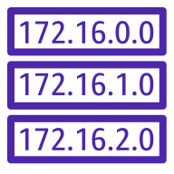

VPC Route Tables
Internet Gateways (IGW) & NAT Gateways (NGW)
VPC
Availability Zone 1
10.1.0.0/16
Availability Zone 2
Internet
Private subnet 1
0.0.0.0/0 → IGW
Internet gateway (IGW)
10.1.0.0/16 → local
Public subnet
The VPC Route table directs traffic to its destination
NAT Gateway (NGW)
EC2 Instance
rtb-789
32.14.196.7
10.1.5.0/24
0.0.0.0/0 → NGW
Not dynamic
New routes need to be configured *
10.1.5.0/24 → eni-123
EC2 Instance
10.1.0.0/16 → local
10.1.4.0/24
Private subnet 2
Private subnet 3
rtb-456
Can have many route tables per VPC
EC2 Instance
with (ENI-123)
10.1.0.0/16 → local
EC2 Instance
10.1.2.0/24
A subnet can be associated to only one route table
10.1.1.0/24
rtb-123
* Except for propagated routes from a VGW
Notes:
Now we are going to talk about a very important topic, the VPC route table.
The route table steers the traffic within your VPC.
You create a route table and then you associate subnets to this route table.
A subnet can be associated with a single route table, whereas a route table can contain multiple subnets.
The route table has the summary cidr block, that points to “local” and this allow by default the communication among all the subnets in that vpc
Y
ou can also allocate an IGW to a route table, such that you can allow the subnets associated with this route table to become a public subnet and therefore, they will be able to reach the Internet Public Zone.
If you want to allow a private subnet to reach internet, but blocking the traffic coming from Internet, you can instantiate a NGW and insert a quad zero in the route table that is encompassing this private subnet, and the quad zero will point to the ngw.
Everytime you create a subnet, you need to "associate" it to a specifc route table if you want to define whether it should be public or not; this is not a process that occur dynamically on the route table: You are compelled to manually define each route table.
You can also have specifc route that are more speciifc of your local route, and this is a new feature offered by AWS: in a nutshell this feature allows to forward the traffic generated from one instance towards another instance, that can represent a NGFW: in this example the ec2 instance in the private subnet 10.1.2.0/24 that wants to reach the ec2 instance in 10.1.5.0/24, has its traffic sent towards the ec2-instance in 10.1.1.0/24

Slide 8


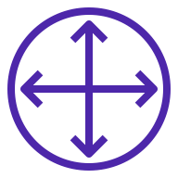

Virtual Private Gateways (VGW)
VPC
10.1.0.0/16
Availability Zone 1
Private subnet 1
Limited to 100 propagated routes
Virtual Private Gateway (VGW)
EC2 Instance
Throughput limited to 1.25 Gbps
10.1.2.0/24
10.9.0.0/16 → VGW (propagated)
Internet
10.1.0.0/16 → local
Availability Zone 2
IPSec VPN
BGP or Static
rtb-456
Private subnet 2
On-premises
DC or Branch
EC2 Instance
10.1.2.0/24
Customer router
10.9.0.0/16
Notes:
Now let’s talk about the vgw, THE VIRTUAL PRIVATE GATEWAY.
Earlier we talked about the networking within the VPC, now let’s deep dive into how the vpc can talk with the outside world.
(click)
You can instantiate a VGW to your VPC, and then you can build up an IPSec tunnel between the VGW and your on-prem DC router.
You can run either BGP in order to automatically advertise your subnets from the DC towards the CSP, or you can also run static routes.
Please keep in mind that the throughput is choked at 1.25Gbps and it can’t go faster than that.
Of course in the route table in order to allow the internal ec2 instances to respond to the traffic coming from the DC, you need to have a route.
With BGP enabled, the VGW can auto-populate the route table in order to allow the ec2 instance to reach the dc, however, only the first 100 routes learnt by the VGW can be auto-propagated. This is the only moment where the route table is dynamically updated, when indeed the VGW carries out the propagation.

Slide 9

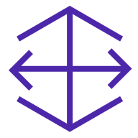
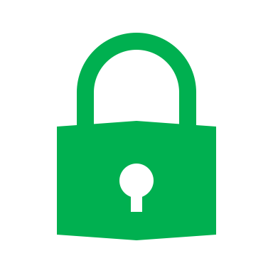
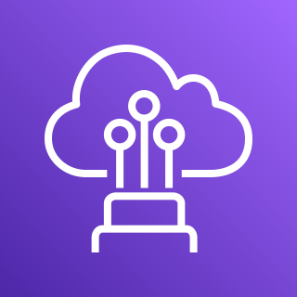
AWS Direct Connect
VPC
1, 10, or 100 Gbps private connection
10.1.0.0/16
Availability Zone 1
Private subnet 1
Limited to 100 propagated routes
Virtual Private Gateway (VGW)
Limited routes
Limited encryption
EC2 Instance
DXGW
10.1.1.0/24
MACSec
BGP
10.9.0.0/16 → VGW (propagated)
10.1.0.0/16 → local
Availability Zone 2
AWS Direct Connect (DX)
rtb-456
Private subnet 2
100 route limit from on-prem
MACSec
On-premises DC
OR
EC2 Instance
10.1.2.0/24
Customer router
10.9.0.0/16
Notes:
If 1.25Gbps is too slow and you want something faster, you can use a service called AWS Direct Connect.
You have a private connection between your on-prem dc router and the DIRECT CONNECT. This Direct Connect is hosted in a Direct Connect facility.
you can request 1, or 10, or 100 Gbps pf throughput. Then I take that Direct Connect and I can associate it to a Direct Connect gw (DXGW) and then I take that DXGW and I associate it to the VGW in order to reach my VPC.
Once these actions has been accomplished, the VGW will also propagate the routes learnt through BGP as we saw before.
There is still a limitation of 100 routes that can be automatically propagated by the VGW inside the VPC.
Moreover, the DC can only advertise 100 routes, conversely from my VPC I can only advertise 20 routes towards the DC router and the auto-summarization is not supported, you need to do it manually.
You need to be very cognizant when you decide to use the DIRECT CONNECT.

Slide 10
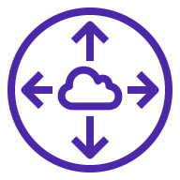
VPC Peering
Full mesh required
Messy and configuration intense at scale
10.4.0.0/16 → pcx-789
10.3.0.0/16 → pcx-456
10.4.0.0/16 → pcx-789
AWS Region
AWS Region
10.2.0.0/16 → pcx-123
10.1.0.0/16 → pcx-456
10.1.0.0/16 → local
10.2.0.0/16 → pcx-123
10.3.0.0/16 → local
VPC
VPC
10.1.0.0/16
Peering connection
10.3.0.0/16
rtb-002
rtb-003
EC2 Instance
EC2 Instance
Non-transitive
Peering connection
10.1.0.0/16 → pcx-789
Peering connection
Peering connection
10.3.0.0/16 → pcx-456
10.2.0.0/16 → pcx-123
10.4.0.0/16 → local
VPC
VPC
10.4.0.0/16
10.2.0.0/16
Peering connection
rtb-004
EC2 Instance
10.4.0.0/16 → pcx-005
EC2 Instance
10.3.0.0/16 → pcx-001
10.1.0.0/16 → pcx-123
10.2.0.0/16 → local
rtb-001
Notes:
The VPCs in the same region or in different regions can talk to each other, and what you have to do is to peering them together.
When you establish a peering connection you will establish connectivity between the two VPCs, however you have to manually take care of the route table configuration.
As I said before, You can establish the vpc peering across regions.
However, they are not transitive , I can’t hop from one VPC to get to another, you are compelled to create a full mesh peering structure if you want that all VPCs can talk together; this is the requirement. At the same time, you need to manipulate all the route tables per each VPC and this can become a tidious endeavor.
So, as you can see the configuration is quite intense and messy.

Slide 11
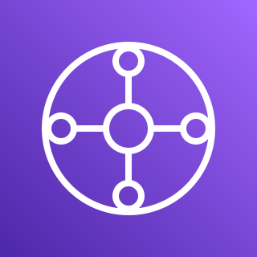
AWS Transit Gateway (TGW)
AWS Region 1
AWS Region 2
Static VPC route table entries
VPC A
VPC E
10.1.0.0/16
Limited visibility
10.5.0.0/16
VPC B
VPC F
10.2.0.0/16
TGW Peering
10.5.0.0/16
VPC C
Static Routing*
VPC G
10.3.0.0/16
AWS Transit Gateway
10.7.0.0/16
VPC D
Max 50 Gbps
throughput
VPC H
10.4.0.0/16
10.8.0.0/16
Notes:
This is the reason why AWS created the AWS TGW.
This is the AWS Transit GW, please do not confuse it with the Aviatrix Transit GW.
How does the aws TGW work? In a nushell, I will establish a peering between each VPC and the TGW, specifically I will create attachment between each vpc and the TGW. The TGW is a regional construct, it does not span regions, whereby if I want to allow a vpc in region 1 to communicate with a vpc in region 2, I have to build up a peering between the two TGWs.
For the time being, there is no BGP running between the two tgws, this means that everything is based on static routing.
Forget about netflow, there is a limited visibility offered with the TGW service.
Once again, you have to manage all the static routes inside the route table of each corresponding VPC connected to the TGW.
The TGW is not going to auto-propagate the routes. You need to insert the entry in the route tables.
The TGW has a maximum throughput of 50 Gbps.
Let’s have a look at what is inside the TGW..

Slide 12

Inside the AWS Transit Gateway (TGW)
10.0.0.0/8 → TGW
VPC Attachments
10.0.0.0/8 → TGW
VPC D
TGW Route Tables
VPC F
10.4.0.0/16
Route Propagation
10.5.0.0/16
1
10.4.0.0/16 → Attach #1
5
2
10.3.0.0/16 → Attach #2
10.4.0.0/16 → Attach #1
VPC C
10.3.0.0/16 → Attach #2
10.3.0.0/16
0.0.0.0/0 → Attach #5
10.2.0.0/16 → Attach #3
Appliance VPC
10.1.0.0/16 → Attach #4
10.0.0.0/8 → TGW
10.5.0.0/16 → Attach #5
Route Table Associations
10.9.0.0/16 → Attach #6
20 route limit
6
3
10.2.0.0/16 → Attach #3
10.0.0.0/8 → TGW
10.1.0.0/16 → Attach #4
VPC B
DXGW
100 route limit
0.0.0.0/0 → Attach #5
0.0.0.0/0 → Attach #5
10.2.0.0/16
4
On-premises
VPC A
Static Routes
10.1.0.0/16
Customer router
10.0.0.0/8 → TGW
10.9.0.0/16
Notes:
Inside the TGW you have Route Tables. You can configure multiple Route Tables. You can have up to twenty of this.
In this example, in the piccture depicted in the slide we have 4 route tables.
Now we have our VPCs that want to talk to each other.
So, What am I going to do here?
The very first thing that I am going to do is to create the VPC attachments! Each attachment has an attachment number.
You can attach various type of VPCs, for example in this case I have also an inspection VPC that is hosting a pair of firewalls.
You can also attach your Direct Connect GW to the TGW.
Afterwards,
I need to associate my attachments to specific routing tables. This is another configuration that I have to do.
There is a lot of configuration that we need to do in order to achieve a desired result.
What we are trying to do is to steer the traffic towards the inspection VPC.

Slide 13
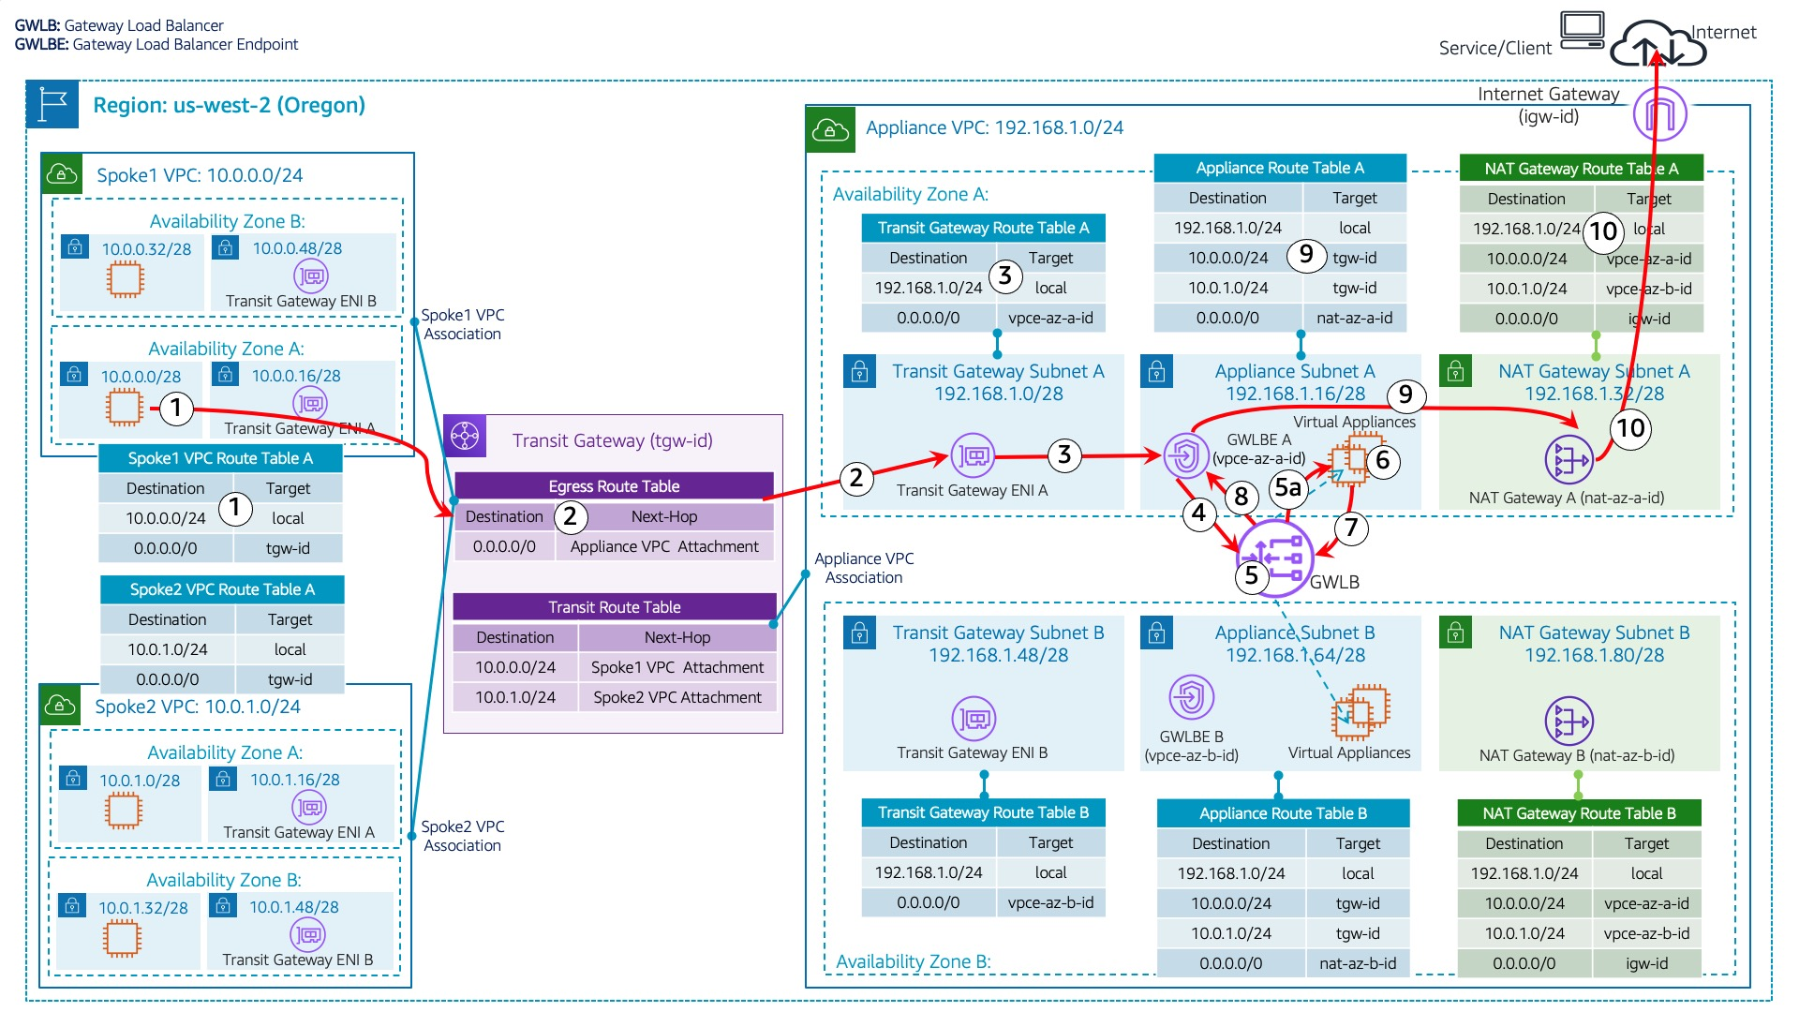
AWS Gateway Load Balancer (GWLB)
Source:
https://aws.amazon.com/blogs/networking-and-content-delivery/centralized-inspection-architecture-with-aws-gateway-load-balancer-and-aws-transit-gateway/

Slide 14
AWS Transit Gateway Connect
Routing with the TGW over a GRE Tunnel
*Up to 4 GRE Tunnels (TGW Connect Peers)
per Connect attachment for 20 Gbps
1000 routes
VPC A
10.1.0.0/16
5000 routes
VPC B
GRE Tunnel (5 Gbps*)
VPC E
TGW
SD-WAN
10.2.0.0/16
BGP Peering
VPC C
Connect attachment
NVA
10.3.0.0/16
1000 routes
VPC D
GRE Tunnel (5 Gbps*)
5000 routes
On-premises
data center
10.4.0.0/16
BGP Peering
Customer router
DXGW
Direct Connect

Slide 15
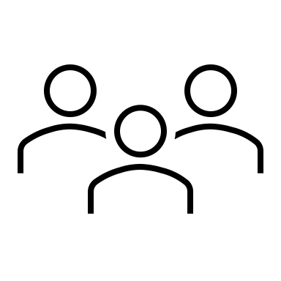
AWS Local Zones
Oregon
Los Angeles
AWS Region
AWS Region
Availability Zone
Data center
Data center
Internet
Local Zone
Availability Zone
Data center
Data center
AWS Global Backbone
Data center
Internet
Extends an AWS Region to a metro area for lower latency access to AWS

Slide 16
AWS Local Zones
Oregon
Los Angeles
AWS Region
VPC
Availability Zone
VPC subnet
Data center
Data center
VPC subnet
VPC subnet
VPC subnet
Internet
Local Zone
Availability Zone
Data center
Data center
VPC
Peering connection
VPC subnet
AWS Transit Gateway
AWS Global Backbone
VPC subnet
Data center
Internet
Not all AWS services exist in the Local Zone

Slide 17
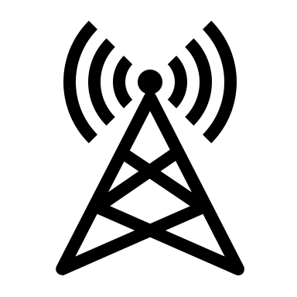
AWS Wavelength Zones
Oregon
AWS Region
AWS Region
VPC
Availability Zone
VPC subnet
Data center
Data center
VPC subnet
VPC subnet
VPC subnet
Internet
Mobile Users
Availability Zone
Data center
Data center
VPC
Wavelength Zone
Peering connection
VPC subnet
AWS Transit Gateway
AWS Global Backbone
VPC subnet
Data center
Wireless Carrier
Extends an AWS Region to a wireless carrier for lower latency access to AWS

Slide 18
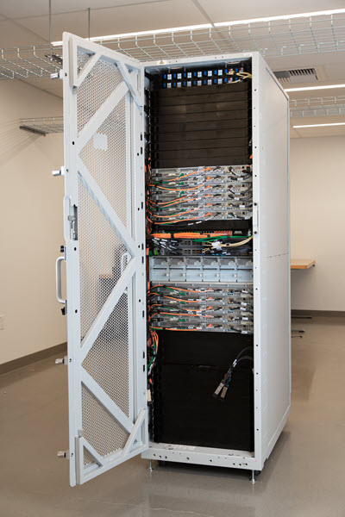
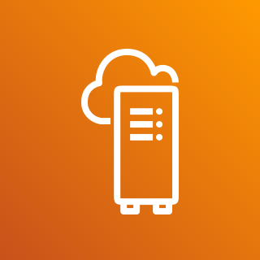

AWS Outposts
Oregon
AWS Region
AWS Region
VPC
Availability Zone
VPC subnet
Data center
Data center
VPC subnet
VPC subnet
VPC subnet
Internet
Availability Zone
Data center
Data center
On-premises
data center
VPC
Peering connection
VPC subnet
AWS Transit Gateway
AWS Global Backbone
Direct Connect
VPC subnet
Data center
AWS Outposts
rack
On-prem server
Extends an AWS Region to customer on-premises for lower latency access to AWS

Slide 19
AWS Transit Gateway – Operational Visibility Considerations
Basic Layer 3 connectivity
Manual and complex traffic steering and isolation
Manual VPC Route Table management
VPC to VPC routes
VPC to on-prem routes
“Black box” – very little visibility
No troubleshooting tools like packet captures
BGP Support
Limited routes on DX
20 manually advertised routes to on-prem
100 routes max to AWS (101 route break everything)
TGW doesn’t pass any BGP attributes to peers
No BGP attributes shown in the route table
No automatic VPC CIDR summarization
AWS Region 1
VPC A
10.1.0.0/16
VPC B
10.2.0.0/16
VPC C
DXGW
10.3.0.0/16
VPC D
On-premises
10.4.0.0/16
Customer router
Notes:
What are the challenges when you operate with the TGW?
Basically, this is a L3 router.
It doesn’t do anything at L4, It only looks at the destination IP address
It requires a lot of manual endeavor to get the traffic moved as you want.
You need to manually configure the route tables in order to allow the traffic to leave a VPC and reach another VPC, or the on-prem DC.
Lack of visibility, because the tgw does not export any netflow piece of information.
You can’t do any packet capture, forget about downloading a .pcap file that you can open up with wireshark.
Last but not least, there are a lot of limitation when you use BGP.

Slide 20
AWS Transit Gateway – Operational and Visibility Challenges
Basic Layer 3 connectivity
Manual and complex traffic steering and isolation
Manual VPC Route Table management
VPC to VPC routes
VPC to on-prem routes
“Black box” – very little visibility
No troubleshooting tools like packet captures
No NetFlow data for visualization and monitoring
BGP Support
Limited routes on DX
20 manually advertised routes to onprem*
100 routes max to AWS (101 routes break everything)**
TGW doesn’t pass any BGP attributes to peers
No BGP attributes shown in the route table
No automatic VPC CIDR summarization
AWS Region 1
VPC A
10.1.0.0/16
VPC B
10.2.0.0/16
VPC C
DXGW
10.3.0.0/16
VPC D
On-premises
data center
10.4.0.0/16
Customer router
*5000 BGP routes to onprem with TGW Connect
**1000 BGP routes to AWS with TGW Connect
Notes:
Unhide for instructor-led

Slide 21
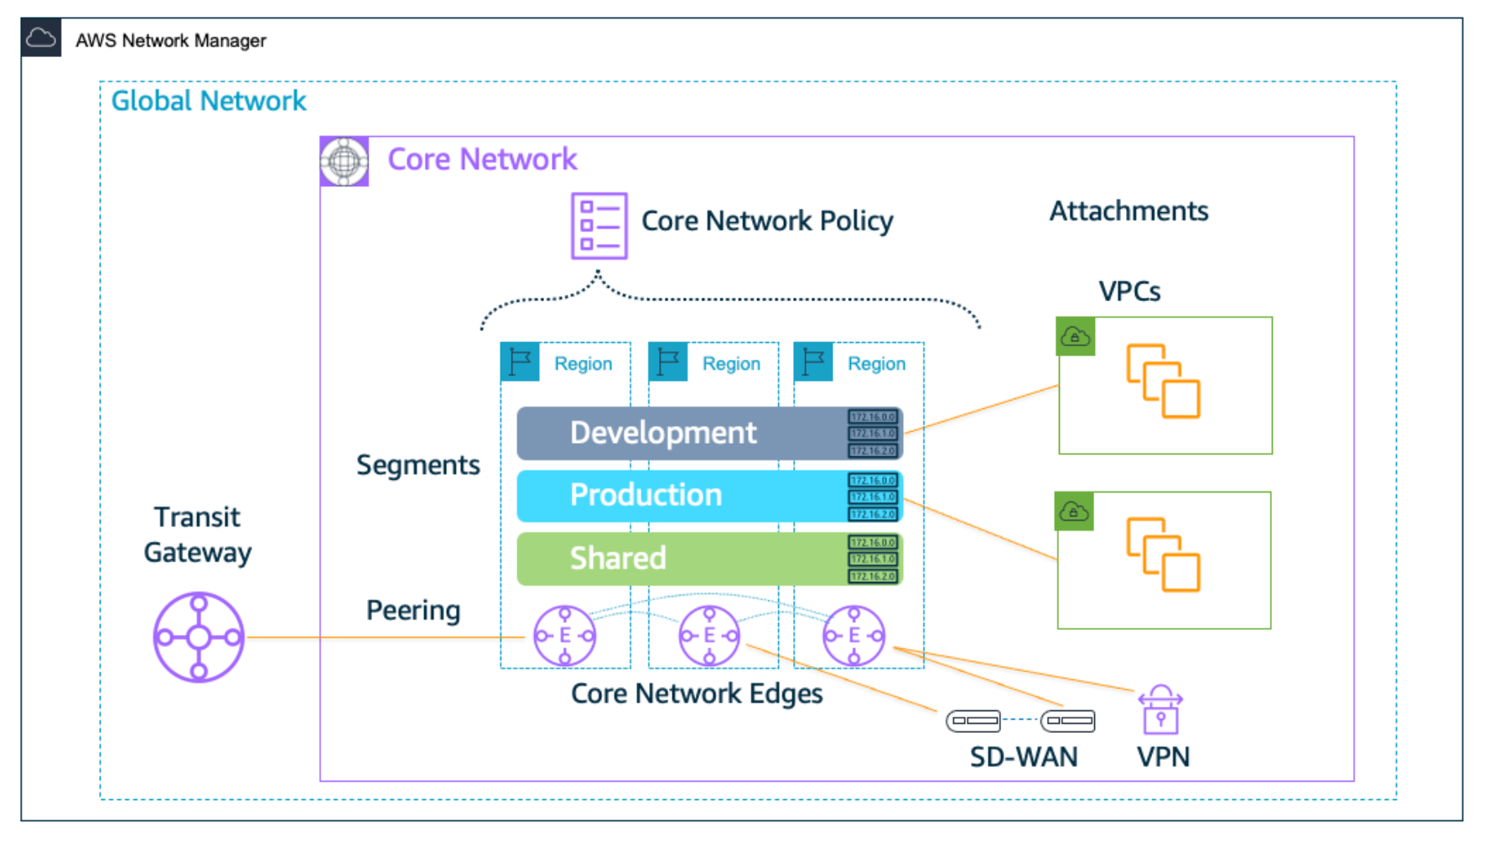
AWS Cloud WAN
Orchestrates VPC Segmentation and Isolation
Orchestrates multi region network peering
JSON Policy document defines
Zones and Policies
AWS only
TGW under the hood, with the same limited troubleshooting and visibility
Not free
https://aws.amazon.com/cloud-wan/pricing/
Notes:
AWS Cloud WAN was introduced recently.
Let’s assume that we have a global network on many aws regions and you want to segment those networks , dev, test and shared
This service orchestrate VPC segmentation and segeregation.
It orchestrates multi network peerings.
These are called core network edges, but they are tgws under the hood
You can do everything with a json file that defines what region you wanna be in, what segment can talk to each other.
It sounds great but this is confied to aws only, it is not a multicloud service.
And there are still a lot of limitations, very similar to what we discussed before with the TGW, specifically a lakc of troubleshooting tools
And not free

Slide 22
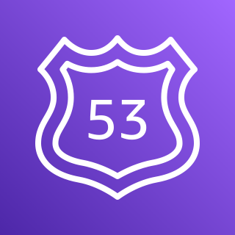
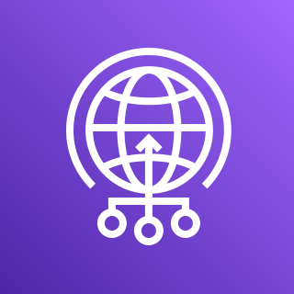
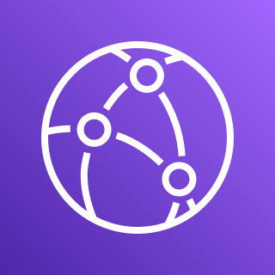
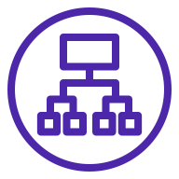
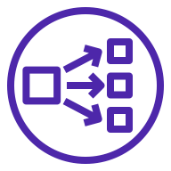


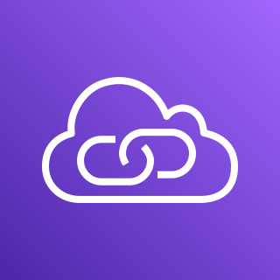
Other AWS Networking Services
AWS account
AWS Region
AWS Elastic Load Balancing
Amazon Route 53
AWS Global Accelerator
Amazon CloudFront
Availability Zone 1
Availability Zone 2
AWS Interface Endpoints
VPC
10.1.0.0/16
AWS PrivateLink
Application Load Balancer
Network Load Balancer
Public subnet
Public subnet
Amazon Route 53 (DNS)
EC2 Instance
AWS Global Accelerator
EC2 Instance
10.1.3.0/24
10.1.4.0/24
Amazon CloudFront
Flow logs
Private subnet
Private subnet
Customer VPC
EC2 Instance
EC2 Instance
Endpoints
10.1.1.0/24
10.1.2.0/24
Endpoints
AWS PrivateLink

Slide 23
Aviatrix can help Enterprises with …
Single operational model for Cloud and Aviatrix Equinix Edge
Migration of workload using Equinix Express Route Service
Cloud DR using Equinix
Equinix connectivity between AWS and Azure
High-Performance Encryption from Equinix to Azure
Extending the Cloud operating model to Equinix Edge locations
Extending Network and Micro-Segmentation across Clouds and Equinix Edge
Azure vWAN, AWS CloudWAN, GCP NCC etc. are single cloud options with limitations
Advanced BGP knobs / Advanced NAT / Mapped NAT / Overlapping IP Addresses
Single automation / terraform framework

Slide 24
Next: Azure Networking 101

